Slide 1


Semester 01
BCA with Specialization in Full Stack Development
Kanban Principles
Module 9
Kanban Principles
Notes:
Notes to the Facilitator:
Welcome the participants and give them an overview of the module. Tell them that they will learn about the ‘Kanban Principles’ in this module.
Notes to the Participants:
You will learn about the ‘Kanban Principles’ in this module.

Slide 2
Module Objectives
Module 9: Kanban Principles
At the end of this module, you will be able to:
Define Kanban principle
Explain Kanban board
Discuss Kanban core practices
Notes:
Notes to the Facilitator:
Explain the module objectives to the participants.
Notes to the Participants:
You will be informed about the module objectives.
At the end of this module, you will be able to:
Define Kanban principle
Explain Kanban board
Discuss Kanban core practices

Slide 3
Module Topics
Module 9: Kanban Principles
Let us take a quick look at the topics that we will cover in this module:
Testing and Debugging
Kanban Principle
Kanban Board
Kanban Core Practices
Make work visible
Limit work in progress (WiP)
Manage flow
Make progress policies explicit
Implement feedback mechanisms
Improve collaboratively (using methods and models).
Notes:
Notes to the Facilitator:
Inform the participants about the topics that they will be learning in this module.
Notes to the Participants:
You will learn about the following topics in this module:
Testing and Debugging
Kanban Principle
Kanban Board
Kanban Core Practices
Make work visible
Limit work in progress (WiP)
Manage flow
Make progress policies explicit

Slide 4
2.1 What is Kanban?
Module 9: Kanban Principles
Kanban means signal card in Japanese.
Kan - Signal
Ban - card
Kanban System means a system that manages work using (real or virtual) Kanbans to control the flow.
Manufacturing
Distribution
consumption
kanban card (or lable) returns to table
red zone
kanban table
if red zone reached, then production (e.g. reconstitution of the consumption)
Notes:
Notes to the Facilitator:
Explain the participants about Kanban.
Notes to the Participant:
Kanban is known as sign board or signal card derived from Japanese.
It was this signal card that the car manufacturer Toyota originally used as a mechanism to help them get the vehicle parts they required just in time. A physical card was sent to the supply as a signal that the plant required more than a certain portion.
A rule that the amount of cards remains the same is essential for this method. Without a formal decision, the number of cards cannot be decreased or increased.

Slide 5
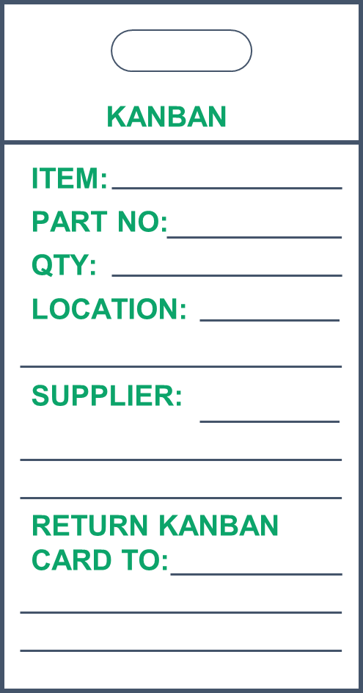
2.1.1 Kanban Cards
Module 9: Kanban Principles
EXAMPLE OF KANBAN CARD
6 3 5 4 5
Pending Analysis Development Test Deploy
Doing Done Doing Done
Notes:
Notes to the Facilitator:
Explain the participants about Kanban cards.
Notes to the Participant:
Kanban cards are a system of visual signals implemented to trigger demands for inventory. These cards are put as required throughout the plant and can have a major effect on productivity and production. In Job fields cards can be used when material and supplies run low, with the card being converted into a material handler to retrieve the product required. The card includes all the necessary essential data, including part number, part description, amount, and places. It is also possible to use Kanban card schemes when ordering from outside vendors, but usually take longer to implement.

Slide 6
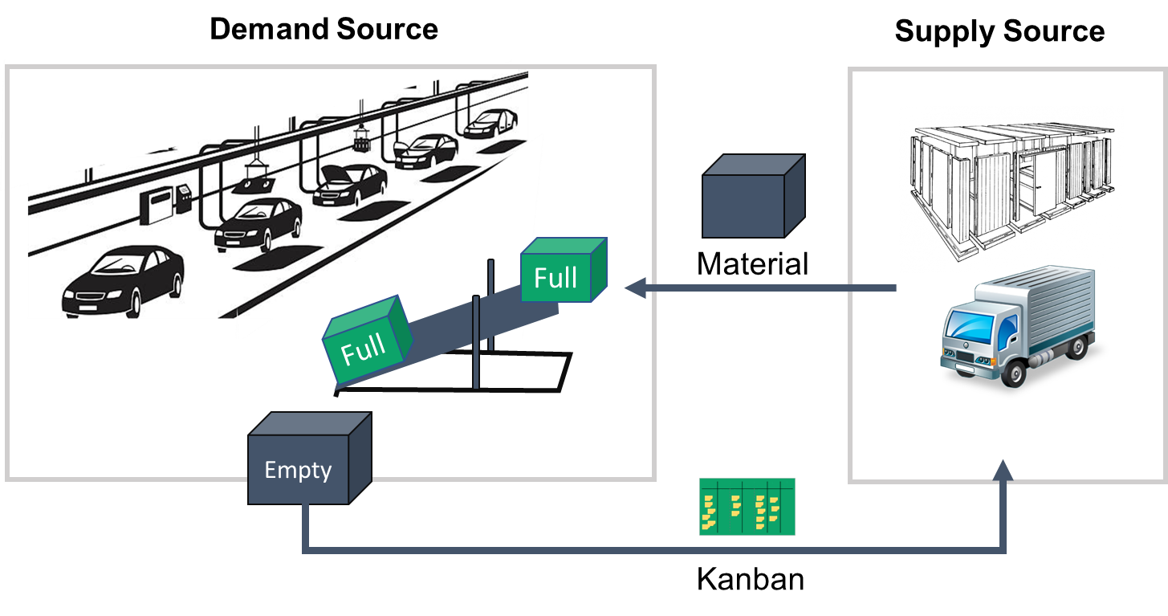
2.2 Kanban Principle
Module 9: Kanban Principles
Notes:
Notes to the Facilitator:
Discuss with the participants about the Kanban Principle.
Notes to the Participant:
Kanban is a very simple process with minimal rules and a handful of general guidelines. As with any process, it can be well applied or misapplied, depending on the context. The work itself might be a good fit for Kanban, or it could be a bad fit. Similarly, because a process is performed by people, the team’s Agile maturity and discipline play a significant part in Kanban’s success.
Kanban was created by the Toyota car manufacturing company in the 1950s. Research into supply chain management in supermarkets resulted in the creation of a feedback loop whereby demand can be used to limit the supply at each phase of production. Toyota identified that supermarkets were supremely efficient in ensuring that stock levels were high enough to consistently meet demand, yet low enough to prevent overstocking.
Since then, Kanban has been re-appropriated from the manufacturing world to the software delivery world, with great success.

Slide 7
2.3 KANBAN Core Practices
Module 9: Kanban Principles
Following are the Kanban core practices
Make work visible
1
Limit work in progress (WiP)
2
Manage flow
3
Make progress policies explicit
4
Implement feedback mechanisms
5
Improve collaboratively (using methods and models)
6
Notes:
Notes to the Facilitator:
Give a brief to the participants about Kanban core practices.
Notes to the Participants:
The core practices of Kanban—the points that must absolutely be considered in order for this adaptive system to function properly. Fundamentally, Kanban stipulates very little in terms of how something should be done; it is more the case that Kanban makes suggestions that something should be done. Stipulations would be counterproductive since it is mostly the people working in the system that should recognize what needs to be changed and what form this change should take. According to David J. Anderson, there are six core practices that make a Kanban implementation successful:
Make work visible
Limit work in progress (WiP)
Manage flow
Make progress policies explicit
Implement feedback mechanisms
Improve collaboratively (using methods and models)

Slide 8
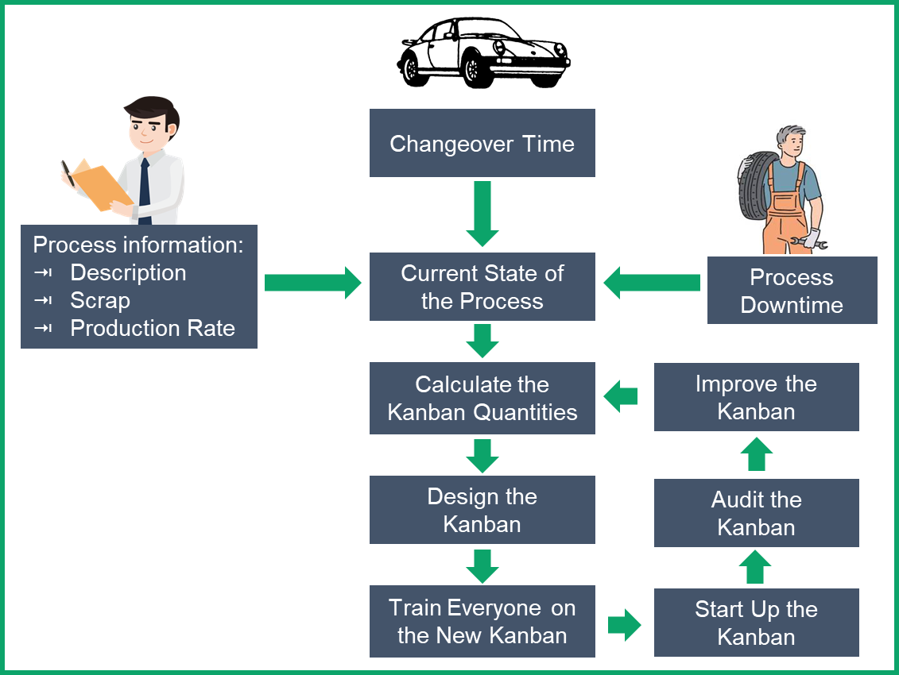
2.3.1 KANBAN Implementation Model
Module 9: Kanban Principles
Notes:
Notes to the Facilitator:
Give a brief to the participants about Kanban implementation model.
Notes to the Participants:
Seven steps to implementing Kanban:
Conduct data collection
Calculate the Kanban Size
Design the Kanban
Train everyone
Start the Kanban
Audit and maintain the Kanban
Improve the Kanban

Slide 9
2.3.2 Make Work Visible
Module 9: Kanban Principles
To Do
Doing
Done
Notes:
Notes to the Facilitator:
Give a brief to the participants about Kanban Core practices – Make work visible.
Notes to the Participants:
The goal of Kanban is to establish a continuous workflow that ultimately generates more value for the customer. Kanban helps make visible the processes of knowledge work, thus also the associated problems that limit the workflow. Initiating quantitative restrictions (WiP limits) for the work makes clear what causes the system to falter and what hinders the completion of operations. This is precisely what happened to the team mentioned earlier: through the visualization of their workflow, it became clear that certain people in the organization should communicate directly with each other in order to improve their processes.
Moreover, the crucial difference between Kanban and other popular modes of operation is that the work doesn’t simply get “passed on” to the next stage of processing as soon as a team member is finished with it (the push principle). It is much more the case that team members of subsequent stages collect the work from the upstream stages as soon as they have the capacity to do so (the pull principle).

Slide 10
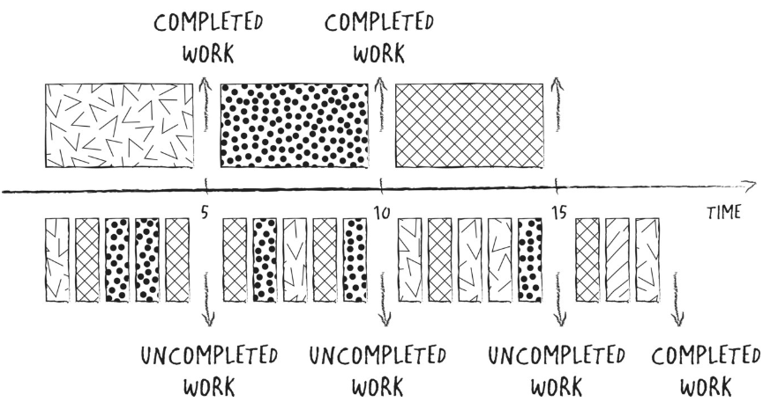
2.3.3 Limit Work in Progress
Module 9: Kanban Principles
Completed Work
Completed Work
5
10
15
Time
Uncompleted Work
Uncompleted Work
Uncompleted Work
Completed Work
Notes:
Notes to the Facilitator:
Give a brief to the participants about Kanban Core practices – Limit work in progress.
Notes to the Participants:
Traditional production management teaches us that unfinished products are tied-up capital. This is why every production organization tries to keep the number of half-finished products as low as possible.
Again, we have the problem that the value of tangible products is easier to quantify than that initially resident in the minds of software developers. In any case, the following is true for both traditional assembly and knowledge work: the greater the number of active operations in the system, the higher the lead times. Let us demonstrate this using the example of allocation.
All that has been assembled and is ready to be delivered can be invoiced, earning the organization money. From an economic perspective, it is thus cleverer to carry out one operation 100% of the way rather than 10% of each of 10 operations. Therefore, in order to reduce the lead times and establish a continuous workflow, it is sensible to limit the number of operations carried out simultaneously at any given stage.
Hence, we talk about limiting the “WiP” or simply about “WiP limits.” The relationship between the number of simultaneous operations and the lead times becomes clear in the above slide.

Slide 11
2.3.4 WIP Limits
Module 9: Kanban Principles
WiP limits make the bottleneck in the stage “test” visible
4 2 2 2
To Do Analysis Development Test Done
Doing Done Doing Done
?
Notes:
Notes to the Facilitator:
Explain the participants about WIP limits in Kanban.
Notes to the Participant:
The work-in-progress (WIP) limits Kanban imposes ensure that the core engineering team is working on a focused set of issues instead of continually working on issues randomly and never finishing. These restrict the number of work items in the Kanban system as a whole in order to avoid the overflow.
Let us look more closely at the situation in the above slide. The employee in Development has completed two work items and thus transfers them to the “Done” column. Work in Analysis has also been completed, but the developer is not allowed to collect it because he observes the WiP limit of two. The test turns out to be the bottleneck in this process because the Test employee is still working on his current work item, observing the WiP limit of one. Only when the tester has completed his work and gathered a new work item from Development can the developer begin with the next work item.

Slide 12




2.3.5 Manage Flow
Module 9: Kanban Principles
Analysis Development Test UAT
Let’s do something about it!
I’m Stuck
I’m too busy
I’m Idle
Notes:
Notes to the Facilitator:
Give a brief to the participants about Kanban Core practices – Manage flow.
Notes to the Participants:
The Kanban focus is on the workflow. This means that everything that hampers the flow of work, such as blockers and bottlenecks, receives particular attention. The motto is: work on your problems first before going on to new work.
Furthermore, we want to be able to honor agreements we make with our partners enabling us to develop our mutual trust. In order to keep promises and honor agreements, we must know precisely what we’re capable of achieving. When we change something, we also want to be able to see whether the changes prove to be of value.
We therefore must measure the extent of our approach to the stated goals. However, this doesn’t mean that we measure the performance of individual employees, but rather the performance of our Kanban system.
We want to examine whether we have shaped and developed our capacities and processes in this segment of the value chain in such a way that they can deal with the required tasks. If they can’t deal with the tasks, we must change them again—this is the basis of a kaizen culture.

Slide 13
2.3.6 Make Progress Policies Explicit
Module 9: Kanban Principles
2 3 3 2
Next Analysis Development Acceptance Prod
Doing Done Doing Done Doing Done
Definition of Done
Goal is clear
First tasks defined
Story split (if necessary)
Definition of Done
Code clean & checked in on trunk
Integrated & regression tested
Running on UAT environment
Definition of Done
Customer accepted
Ready for production
Policy
Notes:
Notes to the Facilitator:
Give a brief to the participants about Kanban Core practices – Make progress policies explicit.
Notes to the Participants:
The work style of a Kanban team can be seen as a collection of policies that the group imposes upon itself. These policies are to be transparent to all participants and must be adhered to and have two effects:
Errors and aspects of a policy that sometimes need to be changed can only be identified when both the team and the stakeholders adhere to the policies. The training course we relocated to the neighboring café is an excellent example. The baristas immediately realized that the policy “everyone must stand in a single line, regardless of the particular type of order they would like to make,” was no longer feasible when 25 rather than five customers suddenly congregated at the counter. One of the first policies states that a problem should be solved as soon as it appears. The policies themselves are no exception to this: if a policy is no longer effective, it should be changed. The moment we stop changing our policies and standards, we halt the process of improvement.
Policies remove a large portion of emotion from the discussions. One moves from subjective accusations of guilt to significantly more objective discussions about policies, making consensus on subjects in dispute more likely. This effect is not always immediately apparent. Initially, due to established habits, a guilty party is often sought when a policy isn’t adhered to. At the very least, someone should assume the responsibility of raising conversations to the pertinent level, where the policies themselves and not the individual people are the subject of the discussions.

Slide 14
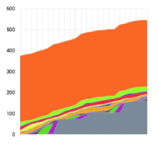
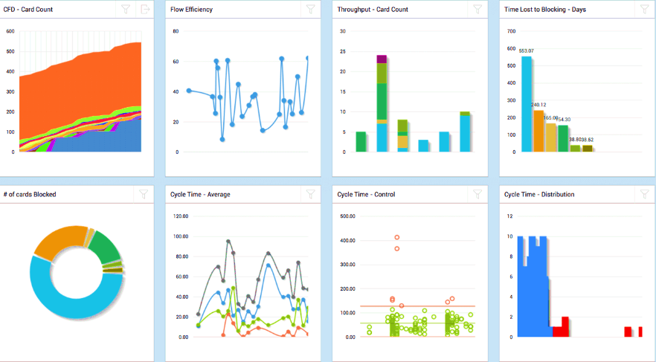
2.3.7 Implement Feedback Mechanisms
Module 9: Kanban Principles
# of cards Blocked
Cycle Time – Average
Cycle Time – Control
Cycle Time - Distribution
600
80
30
700
500
25
600
60
500
400
20
300
40
400
15
300
200
10
200
20
100
5
100
0
0
0
0
CFD - Card Count
Flow Efficiency
Throughput - Card Count
Time Lost to Blocking - Days
120.00
500.00
100.00
12
400.00
10
80.00
300.00
8
60.00
200.00
6
40.00
100.00
4
20.00
2
0.00
0.00
0
Notes:
Notes to the Facilitator:
Give a brief to the participants about Kanban Core practices – Implement feedback mechanisms.
Notes to the Participants:
With Kanban, everything is focused on achieving continuous improvement. Learning plays a decisive role. In order for us to be able to learn something, we need feedback to identify what we can do better. For example, many organizations opt for daily stand-up meetings where feedback about the current work situation is exchanged. We recommend that these meetings take place not only at the team level, but also on a larger scale, encompassing the entire value chain.
The number of participants can be restricted by using delegates of individual teams to coordinate those of other teams in front of the board. Retrospectives, targeted improvement meetings, are also an important feedback mechanism.
The following maxim applies: the broader the spectrum of participants, the better the feedback. Operational reviews are often used for organization-wide learning about metrics. Whatever helps establish high-quality feedback about the actual process should be integrated into the everyday working practice in order to learn and improve.

Slide 15
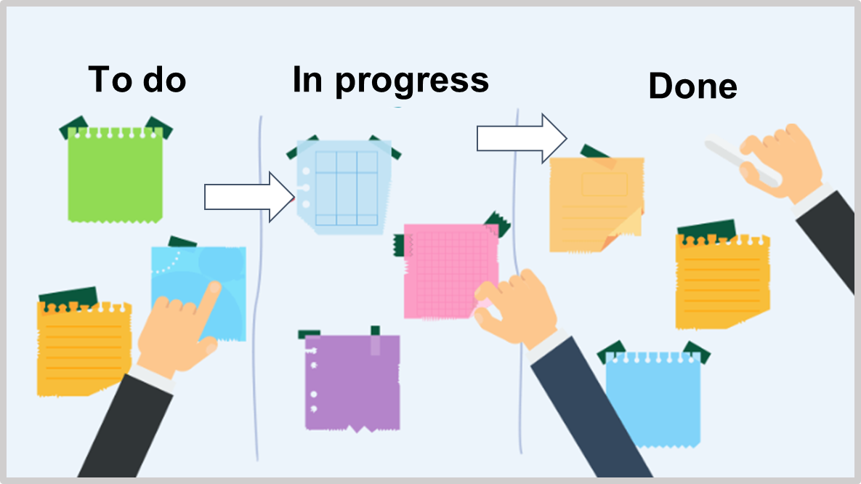
2.3.8 Improve Collaboratively
Module 9: Kanban Principles
Notes:
Notes to the Facilitator:
Give a brief to the participants about Kanban Core practices – Improve collaboratively.
Notes to the Participants:
Improvement doesn’t mean that we constantly have to reinvent the wheel. In the case of multiple problems, we can fall back on approaches and models that illuminate the sets of problems that constantly reappear in all systems and have hence already proved their value in practice. Kanban is thus itself an adaptation of available practices and ideals—for example, from the automobile industry—for the purposes of software development in particular and knowledge work in general. David J. Anderson found several fitting and well-proven theories for the basic principles of Kanban such as Eliyahu M. Goldratt’s aforementioned theory of constraints; economic understandings of waste in the form of transaction and coordination costs, for example; or the influences of variability on a given system.
Nevertheless, Kanban doesn’t prescribe which models and methods must be applied. This is because the demands and situations are different in every organization. Neither does Kanban prescribe how models and methods should be applied. No assertions are made as to what is right and what is wrong. Just for the various types of visualization, there are already as many possibilities as there are organizations in the world that apply Kanban.

Slide 16

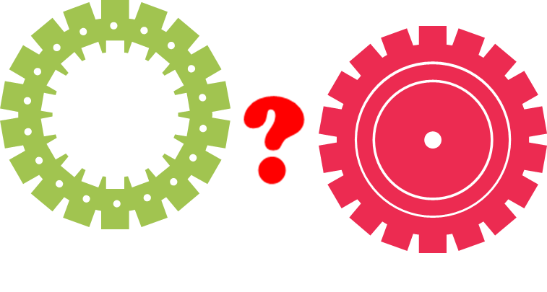

2.4 Value of System
Module 9: Kanban Principles
Your system is everything that happens between when your customer has a need until you have fulfilled the need. In the picture, the system is symbolized with a pipe.
Notes:
Notes to the Facilitator:
Give a brief to the participants about Value of the system.
Notes to the Participants:
Your system is all and everyone engaged in your customer satisfaction process.
It's your workers, associates, support systems, organisation, and routines. The concept behind "system-thinking" is that the outcome depends on how it all works together.
If something goes wrong, the usual reason is not a human error, but something in the scheme is broken; we need to discover the fault or flaw and solve it to get better.
The better our system becomes, the better we meet the expectations of our clients.
If we understand where our demands come from, we need to find out what's going on before we take care of the request and our clients are pleased. You can use a value stream mapping tool to do this.

Slide 17
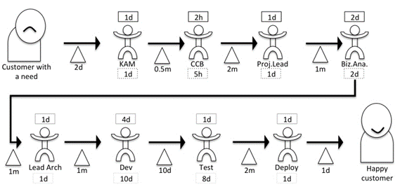
2.4.1 Value of System- Mapping the Process
Module 9: Kanban Principles
Notes:
Notes to the Facilitator:
Give a brief to the participants about Value of the system - Mapping the process.
Notes to the Participants:
Step I – Draw the process steps
Decide on a typical situation, function, or problem that you want to create a value stream map for from the "normal" service class.
To begin with, set the coordinates that will unfold the whole process, that is, the start and the end.
You've got a client at the start with a need to show this with a sad face on your' map' so you're evident where you're going from.
You should have a happy client at the end of the process – specify this with a happy face so that you know exactly where you're going.
Step II – Find the time spent on each process step
1. Draw triangles, symbolizing queues between each step: Sometimes the queue between two steps is empty (meaning the movement between the two steps is practically instantaneous and takes no time to pass).
2. Find elapsed time: For each queue, decide for how long the request on average will be waiting in the queue.
Write those under the queue-triangle. An example of how waiting time is calculated for some different scenarios: If someone checks a mailbox once a week, the average waiting time will be half a week.
3. Look at every step: How long does it take for an average request to pass the step? Write those figures in the square under the step.
4. Find value adding time: Again, look at each step. If this request were the only thing handled at this step and you could work with it without interruptions, how long would it take then? Write this figure above the step.
This might be the same figure as we wrote under the step.
If they work with many things in parallel, have dependencies to other teams, or need to look for answers outside the team, this figure will be lower.

Slide 18
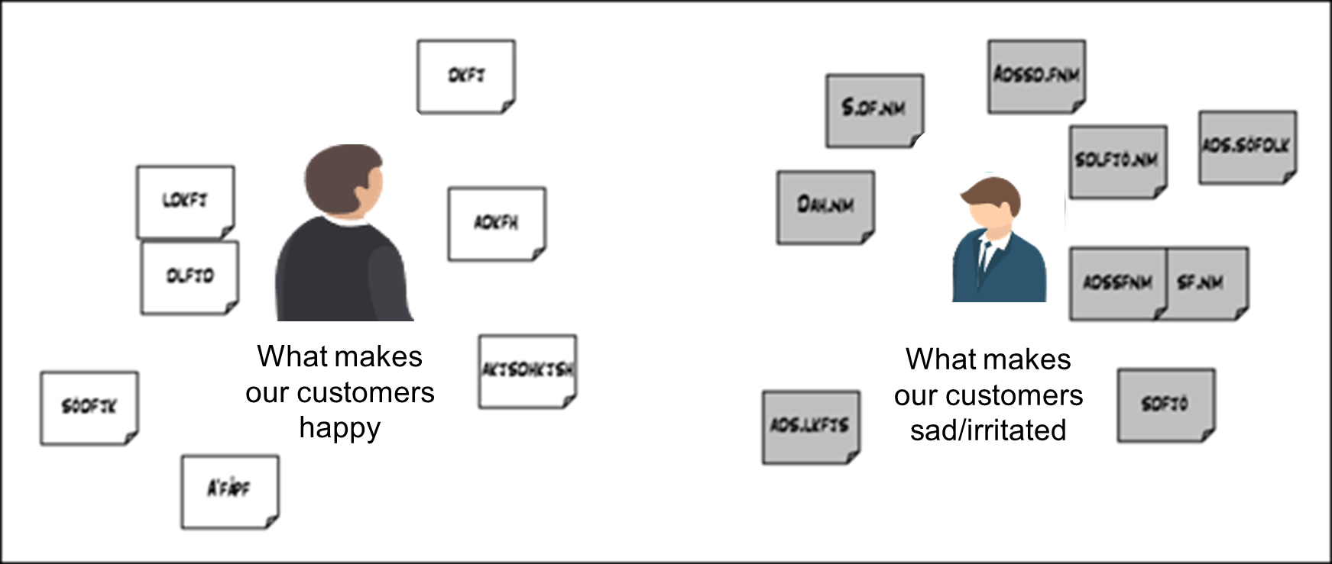
2.4.2 Value of system- Happy Customer
Module 9: Kanban Principles
Notes:
Notes to the Facilitator:
Give a brief to the participants about Value of the system - Happy Customer.
Notes to the Participants:
You need to understand precisely what your customer values are before you begin constructing a board that will assist you enhance the value result for your customer.
Another workshop with your team's appropriate members should be used to attempt to address this issue. Prepare the workshop by drawing on the whiteboard a happy and a sad customer. Get your colleagues back together and begin writing notes to find out the importance of your customers. Here are some of the clearest examples of what your customer will probably value.
• Price
• Service
• Predictability
• Flexibility
• Quick response
• Professional behavior
• Good relevant knowledge
• Honesty
• Collaboration
• Compliance

Slide 19
2.5 Classes of Service
Module 9: Kanban Principles
There are many factors that will dictate how you respond and react to new feature requests
Urgency, which could be set depending on cost of delay, that is, how much it costs or how much you lose by waiting to complete the request
Who requests the change
Size of the request
Whether this request is stopping something else
Notes:
Notes to the Facilitator:
Explain the participants about the classes of service in Kanban.
Notes to the Participant:
Consequently, according to the nature of the request, the action you take in response will be different. Some examples of how your action may be different include:
Maximum time before responding
Way of responding
Way of documenting
Way of following up
Every response requires a different type of service. This is not only because you need to pay attention to the nature of the requests, but also because a certain flexibility and adaptability is essential for your own personal and organizational workflow. Since this touches on something called classes of services, it's worth taking some time to look at this in more detail…
Classes of services are a way of setting a contract for how to handle issues that have close to the same need of service. A typical setup is to use these three classes, which primarily divides the request on their urgency:
Expedite for the most urgent
Intangible for the least urgent
Standard for any others

Slide 20
2.6 Kanban Board
Module 9: Kanban Principles
KANBAN BOARD
BACKLOG 2 | IN DEVELOPMENT 4 MIN 0 MAX 3 | IN TEST 2 MIN 3 MAX 5 | DONE 2
KANBAN -1 Kanban cards represent work items >> Click the "KANBAN-1" link at the top of this card to show the Detail view - | KANBAN -2 Kanban boards are often divided into streams of work. By default, Kanban boards include an
KANBAN-5 Work items flow through different stages from left to right >> Try dragging this card to "Selected for Development" | KANBAN-3 Add work items with "+Create issue" at the top right of the screen >> Try adding a new card now | KANBAN-6 Work in Progress (WiP) limits highlight delays. This column's limit is 1... | KANBAN-9 As teams develop with Kanban they get better at reducing average resolution time (aka cycle time). The Control CHart
 | KANBAN-4 Work items are ranked in priority order (from top to bottom)>> Try dragging this card over the card below to tank its | KANBAN-7 ...so 2 work items violate the limit and cause the column to be highlighted | KANBAN-10 Instructions for deleting this sample board and project are in the description for this issues >> Click the "Kanban-10"
 | KANBAN-8 Filters at the top of the board allow you to quickly cut down the shown items>>
Notes:
Notes to the Facilitator:
Explain the participants about Kanban Board.
Notes to the Participant:
There is no sprint planning with Kanban by default, so instead of having a perspective for backlog grooming, it all occurs straight on the Kanban board.
Working with the board of Kanban is very easy; freshly generated problems are straight added to the board's first column, called Backlog (default), as it acts as your backlog of Kanban problems.
Team members will then pick up problems from the Backlog column, assign them the problem, and move them through the workflow.
Problems may need to be transferred to other customers during different phases.
As more and more problems are over, you can configure the board to bring finished problems off the board automatically after a period of time or execute a release, which will take all issues in the Done column from the board (still in the system).
The first choice is great for teams that use Kanban to manage overall tasks, and the possibility to use releases is better suited to software development where releases can be made.
Let's look at an example of the Kanban board, as shown in the image above, in which we can clearly see that we have problems in both the In Development and In Testing phases of our process.
In Development is highlighted in red, meaning that we have enough work there, which is a sign of a bottleneck.
In Testing is highlighted in yellow, which means that we do not have enough work, which is a sign of efficiency

Slide 21
2.6.1 Kanban Board: Example1
Module 9: Kanban Principles
Wait Analyse Implement Verify Deliver
3 5 2
Specifying Ready for Dev Coding Dev Complete Investigating Accepted Deploying Value Added
1
Notes:
Notes to the Facilitator:
Explain the participants about sample Kanban Board
Notes to the Participant:
The column headers have been deliberately chosen to state their purpose. Backlog is not as clear as Wait. The former is a noun describing a concept of the process that requires further context. The latter is a verb describing the ultimate purpose of the column and the items therein. It is much clearer to the casual observer or those unfamiliar with software development processes to indicate the activity that is performed in each state. Because this is a good example of a common software delivery process, each column—or state—bears further explanation:
Wait: This is the common backlog of work to be started. Work items in this column are not yet in progress, but are possible options for future work. Whether the items within it are bugs, features, technical improvements, or tasks, the backlog is a container for “stuff” that might or might not eventually be worked on. Items are ordered by priority so that the next item is at the top of the column and proceeds in a first-in-first-out (FIFO) queued fashion.
Analyze: Most items in the backlog are single-sentence ideas or descriptions of the problem at hand. No solutions have been decided, and little detail is present. The Analyze column is where sufficient detail is added to the work so that it becomes ready for development. Although some insight into implementation options might be presented, this column emphasizes what needs to be done rather than how it is to be done.
Implement: Implementation can now begin, and developers take over to write the code necessary to add new functionality. This is often the slowest part of the software delivery process and, as this chapter will show, there are ways of optimizing your process to maximize throughput despite this.
Verify: Although some degree of unit testing is expected of the developers in the Implement phase, it is likely that manual and/or automated verification forms part of your delivery process. This is the final gate before the work is delivered, so there should be a high bar set to ensure the consistent quality of work products.
Deliver: When you deliver software, you realize the value that, to this point, has been in progress. All work is incomplete until you have passed through this phase of the process.

Slide 22
2.6.2 Kanban Board: Example2
Module 9: Kanban Principles
A very simple board with status columns and avatar magnets
TO DO DEVELOPING READY FOR TEST TEST DONE
Limit 4 Limit 4 Limit 2 This Week
Notes:
Notes to the Facilitator:
Explain the participants about sample Kanban Board.
Notes to the Participant:
The above example comes from a development team who are disciplined when it comes to breaking things down into small pieces of work.
A board does not need to be complicated—in fact, the simpler the better, as long as it helps the team.
If there is a need to handle very urgent issues there could be a good idea to have a special lane for them. The usual name for that class of service is Expedite. Another way of showing urgency is to have a special picture on top of them. A team that worked for the police authority had a police car to highlight work that was urgent.

Slide 23
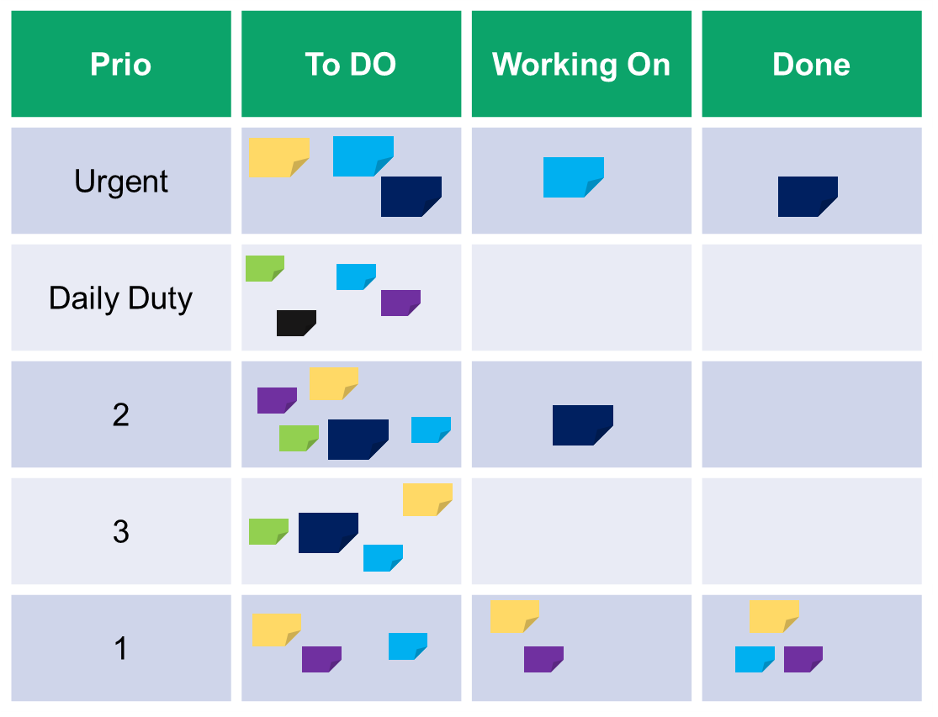
2.6.3 Kanban Board: Example 3– Internal Operation
Module 9: Kanban Principles
A Kanban board for an internal operation department with three classes of services ("to do", "working on", and "done")
Notes:
Notes to the Facilitator:
Explain the participants about sample Kanban Board example which is used for internal operation.
Notes to the Participant:
This example comes from an operation department hosting their own application. An ordinary day for them was a mix of daily duties, firefighting, and small projects to proactively reduce the numbers of fires. The daily duties were typically checking logs and remove old log files.
As you can see on the board this department has divided their work into three classes of services; urgent, daily duties, and proactive work. Urgent has the highest priority, followed by daily duties. The proactive work was done when there were no urgent work to do and the daily duties were done. There could be three proactive projects ongoing in parallel and they had an internal strict prioritization, which was shown with a figure in the first column. Both urgent and proactive work was broken down into tasks.

Slide 24
2.6.4 Kanban Board: Example 4 Without Rows and Columns
Module 9: Kanban Principles
The architectural drawing has become a Kanban board where work is placed on it and the status is visualized with colored lines on the notes
A
C
B
E
Started
D
Done
Notes:
Notes to the Facilitator:
Explain the participants about sample Kanban Board example without rows and columns.
Notes to the Participant:
The above example is interesting; it highlights the fact that, ultimately, a board can look like whatever you want it to look like. Don't feel limited by the examples here and the boards you see for other teams, fix a board that suits your team.
The example here comes from a team that is working with signal enrichment in radio base stations. The idea came from a workshop where the team, together with an expert, went through the architecture for the upcoming development work.
When the architecture was drawn on the whiteboard the team put up notes on the architectural drawing with what work was needed to complete the task.
When this was done, one of the team members said: "Why not use the architectural schema as a board?" This is a great idea but we needed a way of showing the status. Another team member suggested showing the status by colored lines. A green line meant that the work was started and a red line meant that the work was done.

Slide 25

2.7 Meetings in Kanban
Module 9: Kanban Principles
Story start meeting
MEETINGS IN KANBAN SYSTEMS
1
Enterprise sync
2
Review meeting
3
Retrospective meeting
4
Project Kickoff workshop
5
Brainstorming
6
Daily Stand-up
7
Notes:
Notes to the Facilitator:
Explain the participants about different types of meetings in Kanban.
Notes to the Participant:
Story start meeting: When it's time to bring some new work in, we have seen great improvement in efficiency for companies that use story start meetings. It's a meeting only focused on one feature or story. Everybody who will be involved in the work or who has important information about the work is invited to this meeting.
Brief about story start meeting:
When: When it's time to start with a new story, feature or initiative that is not well known
Length: About 60 minutes
Who: Everybody who will be involved in the work or who has important information about the work
Purpose: To get a broad understanding of the work that is about to be done
Enterprise sync: Big companies do usually have many development units, which are dependent on each other. Lack of communication between units is one of the most common reasons for the failure of projects. The enterprise sync is a meeting to improve communication between units and handles things such as:
Corporate or organizational impediments
Status against integration points
Changes that other units may need to know
What we are doing or have learned that could be of interest for other units
Brief about the enterprise sync:
When: 1-5 times a week
Length: 15 minutes
Who: At least one person from every development unit
Purpose: To avoid causing unpleasant surprises for each other, to learn from each other, and take advantage of each others' work
Review meeting: The review is almost like the demo, but is performed in front of a smaller audience and has as its purpose to get feedback about the product and the new features. For companies running demos as described previously, it's a great combination to have reviews like a fair, immediately after the demo, to show more details and have a dialog about how the new features are working. All feedback should be taken care of and be prioritized in such way that you always develop the highest value at any time.
Brief about the review:
When: Every 2-4 week or when you have access to customers, stakeholders or end users
Length: The time it takes
Who: Everybody deeply interested in the development work that is going on
Purpose: To get feedback on the product and newly developed features
Retrospective meeting: The most important meeting in Kanban is the retrospective since this is where we have time to focus on discussing improvements. Retrospectives can be done in many different ways and our recommendation is to vary and not use one version too many times in a row. Below are the three common variations of retrospectives.
THE PLUS-MINUS-DELTA RETROSPECTIVE
FUTURESPECTIVE
THE PERFECTION GAME
Brief about the retrospective:
When: Every 2-4 week or when needed
Length: 1.5 hours
Who: Everybody involved in the development unit
Purpose: To find ways to improve the process or sometimes even the organization
Project Kickoff workshop: Good collaboration at the beginning of a project will almost always result in savings down the line. For that reason, rushed, short kickoff meetings can be a waste of time. Everyone comes to the table with preconceived notions based on limited knowledge about goals, and the resulting tendency is to blend everyone’s baggage into goals for the project. But people are busy and still need to get projects started with a limited amount of time to get on the same page.
Brainstorming: The value of brainstorming is debated, and the practice of brainstorming is defined in different ways and approached with different levels of rigor. There are convincing arguments for it being ineffective at generating new or good ideas. Yet brainstorming endures as a catchy term used to describe the purpose of a meeting. In this case, brainstorming is defined as a collaborative process to generate a high volume of ideas, which increases the odds of having a successful idea.
Daily Stand-up: One way to help the work to flow is to talk about, and do something about, the problems that hinder the work to flow—daily, or even more often. The daily standup meeting (a.k.a. morning meeting, daily, morning call, or standup) was made popular in the software development community in the early agile years with methods such as Scrum and XP. Scrum has the daily standup as a core meeting that’s called Daily Scrum. We think that a daily standup meeting is a great tool to get everyone in the team up to date with the current situation in the team and the status of your work.

Slide 26
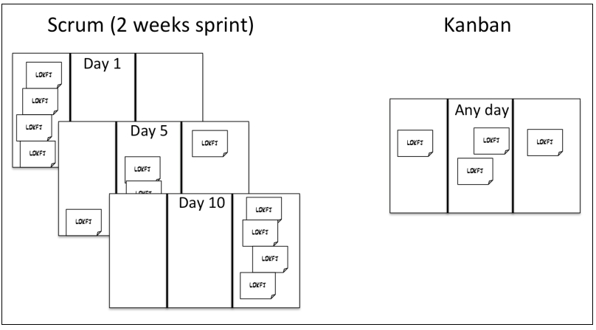
2.8 How to Choose Between Scrum and Kanban?
Module 9: Kanban Principles
Notes:
Notes to the Facilitator:
Explain the participants about Scrum vs Kanban.
Notes to the Participant:
In Scrum you work in an iteration or Sprints of usually 1-4 weeks. Each Sprint starts with the planning of work for the Sprint and ends with a releasable increment of features. Hopefully the plan remains unchanged all through the Sprint.
Kanban has fewer rules. For instance, there is nothing about roles or about working in iterations. Kanban is more focused on continuous flow, visualizing the work and optimizing the time between ideas and runnable features.
This above image shows the difference between Scrum and Kanban flow. You can easily see whether a Scrum team is at the beginning or at the end of a sprint.

Slide 27
In a Nutshell, we learnt:
Module 9: Kanban Principles
Kanban Principle
Kanban Board
Kanban Core Practices
Make work visible
Limit work in progress (WiP)
Manage flow
Make progress policies explicit
Implement feedback mechanisms
Improve collaboratively (using methods and models)
Notes:
Notes to the Facilitator:
Share the module summary with the audience.
Ask the participants if they have any questions. They can ask their queries by raising their hands.
Notes to the Participants:
Now, you have reached the end of the module.
In this module, you have learned:
Kanban Principle
Kanban Board
Kanban Core Practices
Make work visible
Limit work in progress (WiP)
Manage flow
Make progress policies explicit
Implement feedback mechanisms
Improve collaboratively (using methods and models)

